Slide 1

Bacchus Winery Case Study
Milestone #4 – Group Presentation

Slide 2
Group Introduction
Group: Bacchus Winery Case Study
Team members:
DJon Harris
Scott Johnson
Asher Smithson
Jackson Webster
Workflow Summary
Work Contribution Summary
Workflow developed gradually Communication established early Shared collaboration spaces used Weekly task organization supported alignment
Most tasks completed individually Work merged into a final combined deliverable Final project guided by shared outline and team coordination

Slide 3
Case Study Overview
Goal
Modernize tracking for operations and decisions
Visibility Needed
Supplier deliveries, distributor movement of wines, and employee hours.
Expected Outcome
Clearer planning for production, staffing, and marketing.

Slide 4
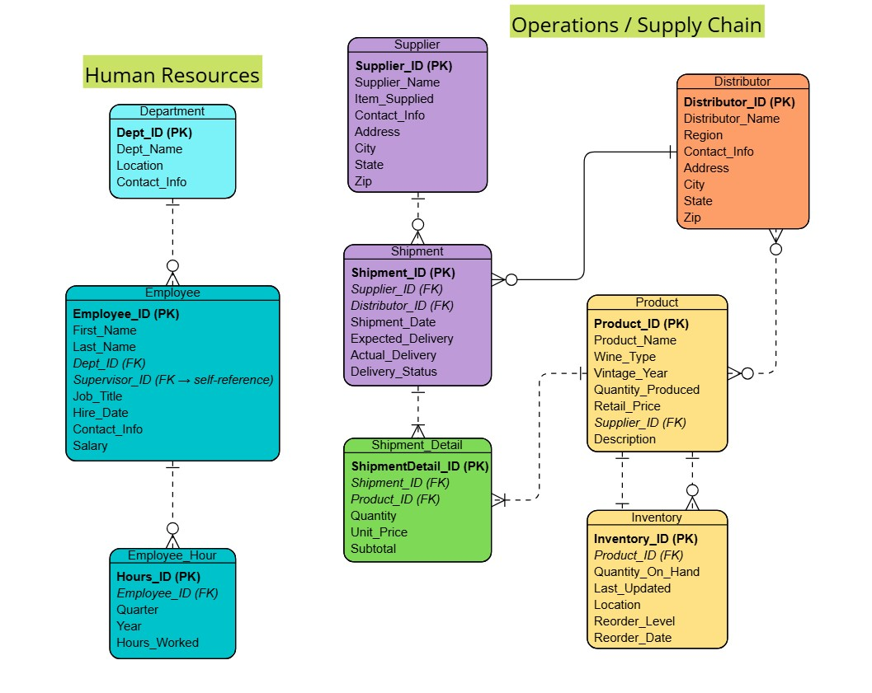
Finalized ERD
ERD created using Visual Paradigm Online ERD Tools

Slide 5
Supplier Delivery Overview
Goal: see how suppliers perform month-by month, how often deliveries are on time, and whether any patterns of early or late shipments appear.
Tables: Supplier → Shipment
Fields: Supplier_Name, Expected_Delivery, Actual_Delivery, Delivery_Status, Shipment_Date
Approach: calculate days early/late, compare expected vs. actual delivery dates, and summarize results by supplier and by month.
Business Reasons: helps identify unreliable suppliers, understand delivery delays that affect production, and guide adjustments to ordering schedules or supplier choices.
Report #1: Supplier Delivery Performance

Slide 6
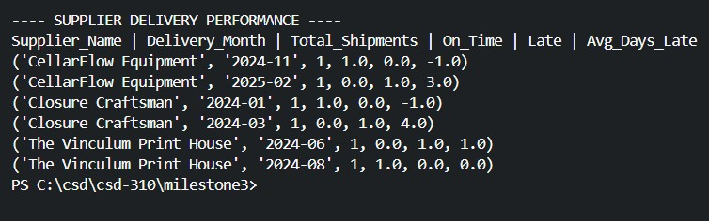
Report 1 – Output Example
Output from report_supplier_delivery.py

Slide 7

Wine Distribution & Sales Trends
Goal: see which wines move faster, which distributors sell more, and which wines underperform.
Tables: Shipment → Shipment_Detail → Product → Distributor
Fields: Wine_Type, Quantity, Unit_Price, Distributor_Name
Approach: SUM quantity and revenue, group by wine type + distributor; optional quarter grouping
Business reason: informs production mix, distributor focus, and marketing
Report #2: Wine Distribution & Sales Report

Slide 8
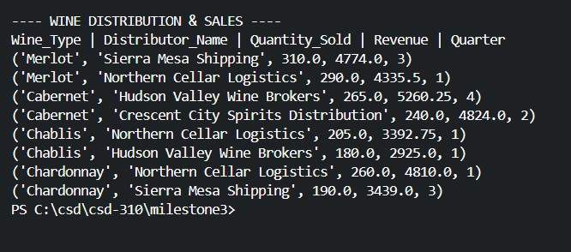
Report 2 – Output Example
Output from report_wine_distribution.py

Slide 9

Employee Hours by Quarter
Goal: view workload trends across last four quarters for staffing/payroll planning
Tables: Employee_Hour → Employee → Department
Fields: Year, Quarter, Hours_Worked
Approach: filter last four quarters; SUM hours per employee/department; optional pivot
Business reason: identify over/under-utilization and guide staffing decisions
Report #3: Employee Hours Report

Slide 10
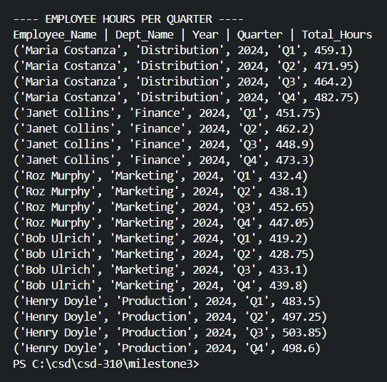
Report 3 – Output Example
Output from report_employee_hours.py

Slide 11
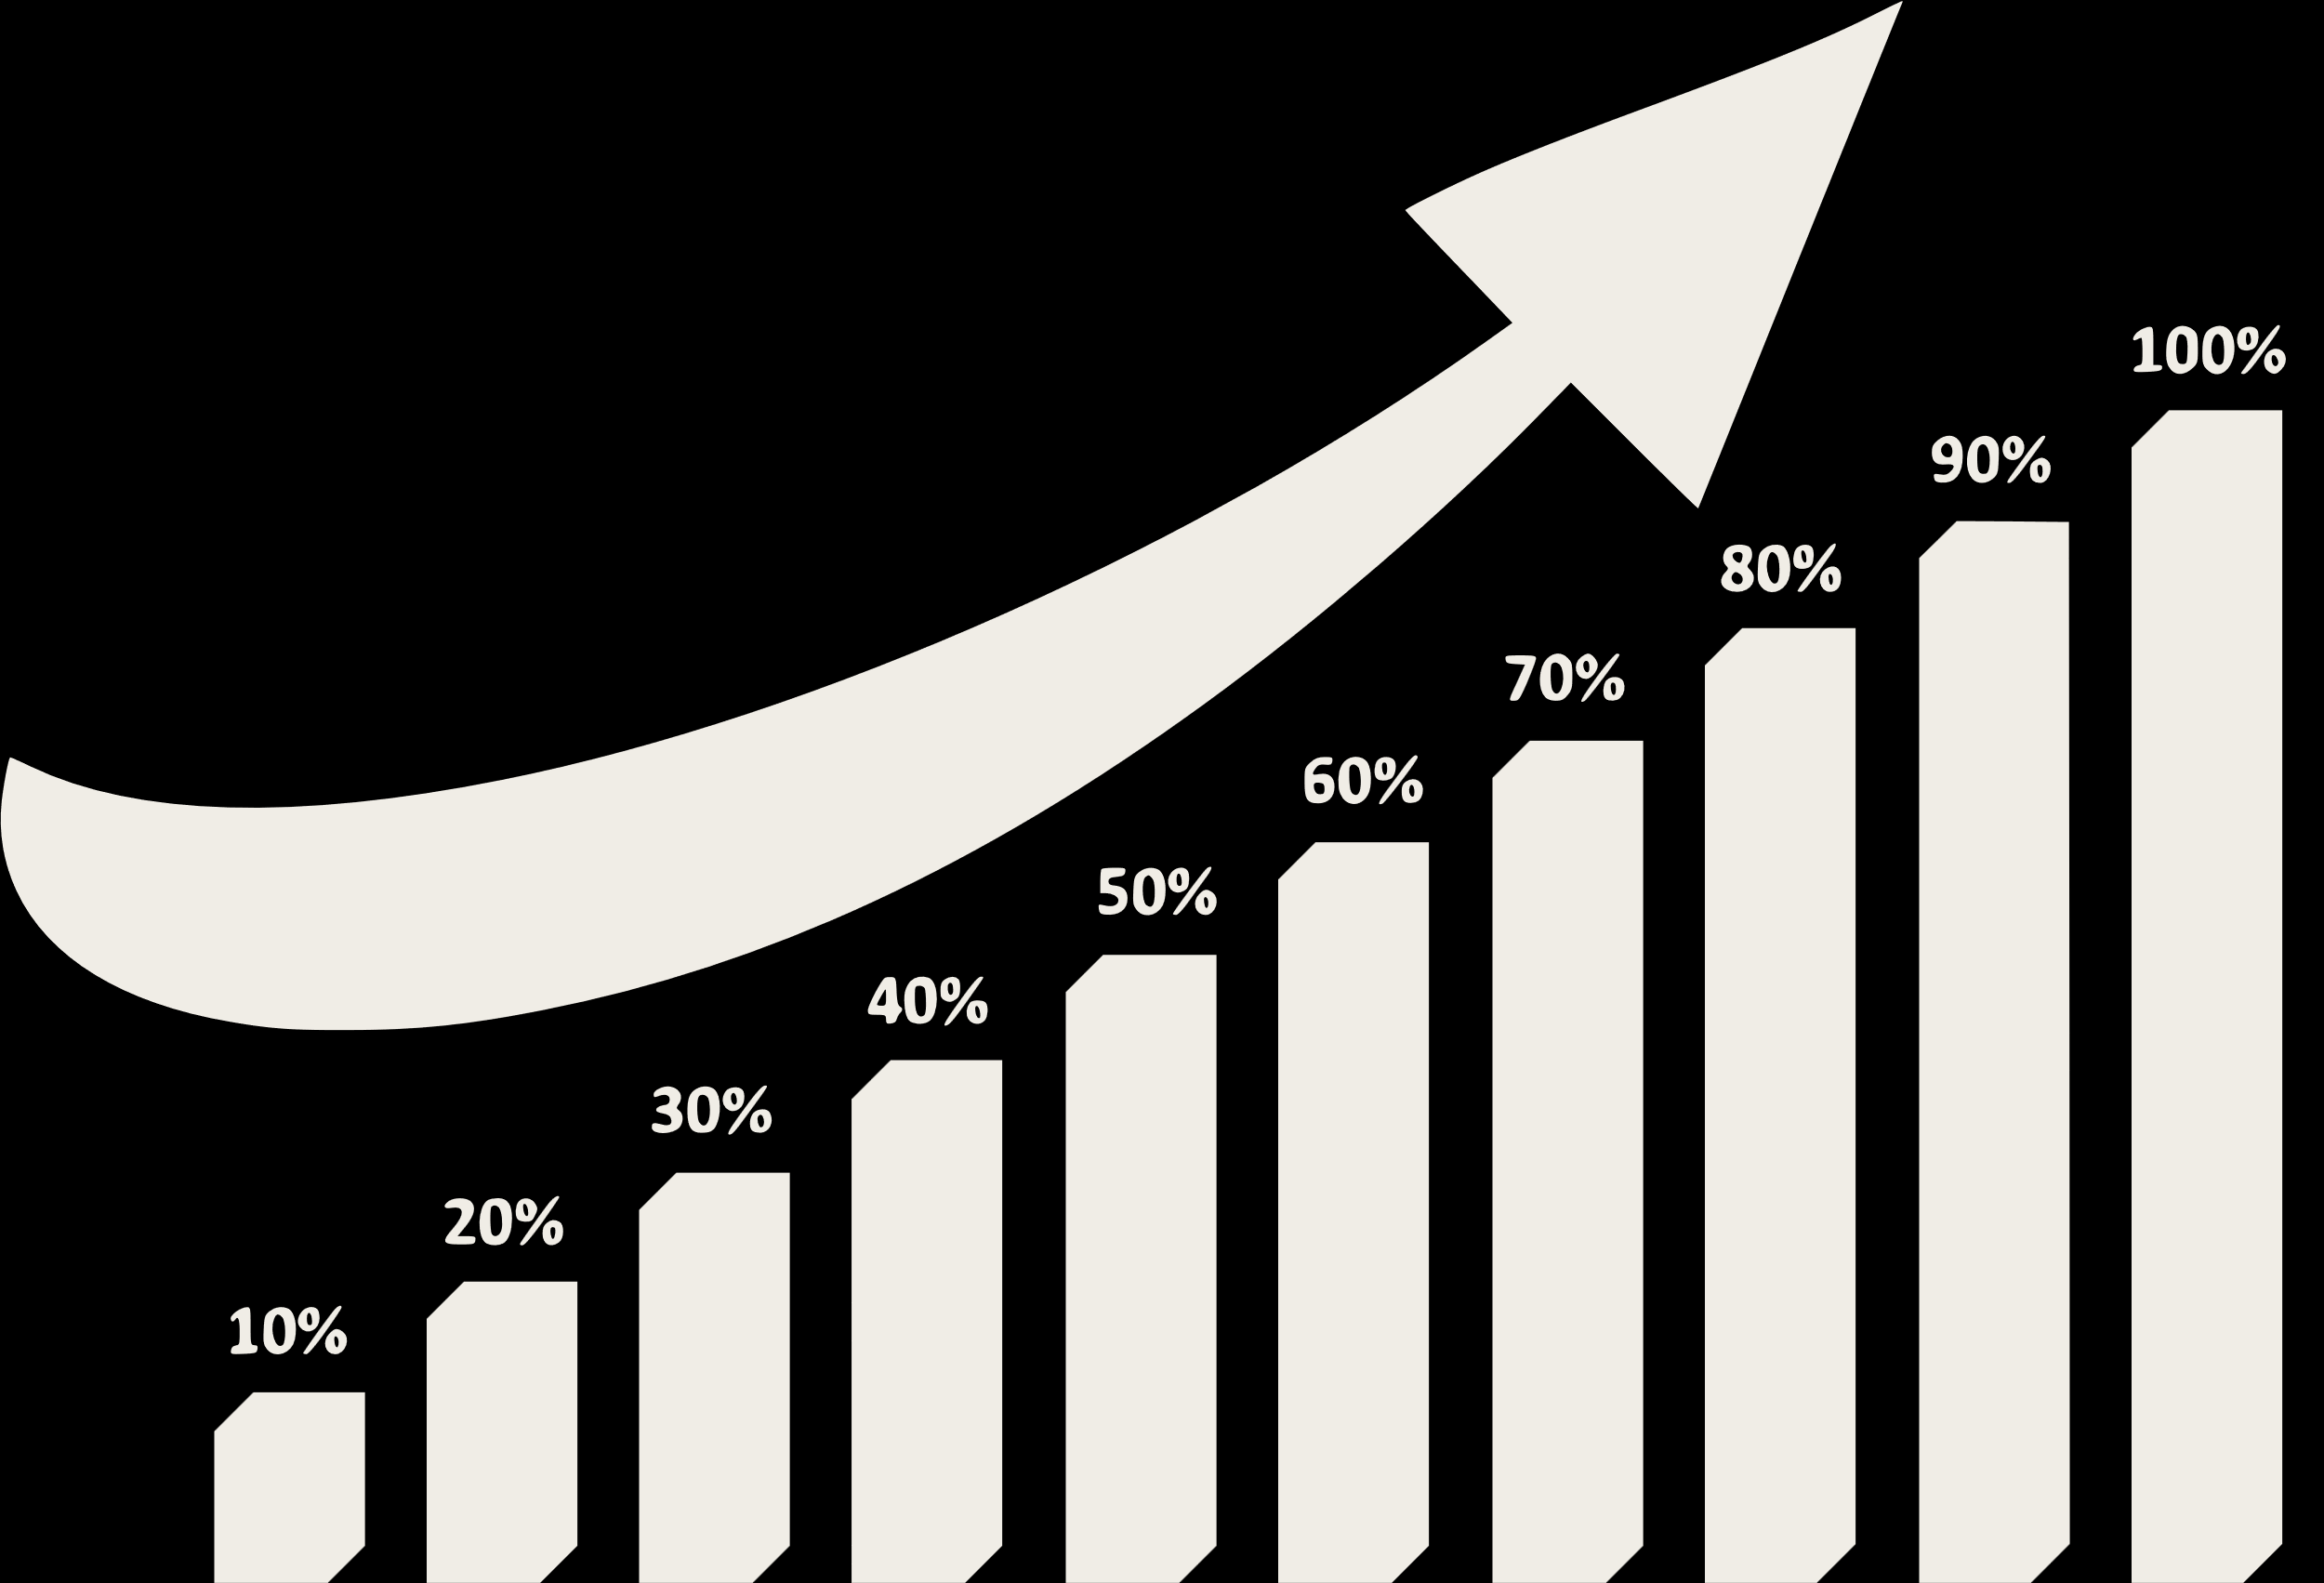
Quarterly Sales Trends
Goal: see how each wine performs quarterly, which products trend upward or slow down, and where sales patterns shift over time.
Tables: Shipment → Shipment_Detail → Product → Distributor
Fields: Wine_Type, Quantity, Unit_Price, Distributor_Name, Quarter
Approach: SUM quantity and revenue, group by wine type + distributor + quarter; compare quarter-to-quarter changes
Business reason: supports production scheduling, seasonal planning, distributor coordination, and identifying rising or lagging wines
Report #4: Quarterly Sales Summary

Slide 12
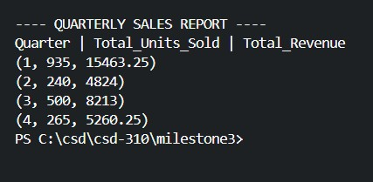
Report 4 – Output Example
Output from report_quarterly_sales.py

Slide 13
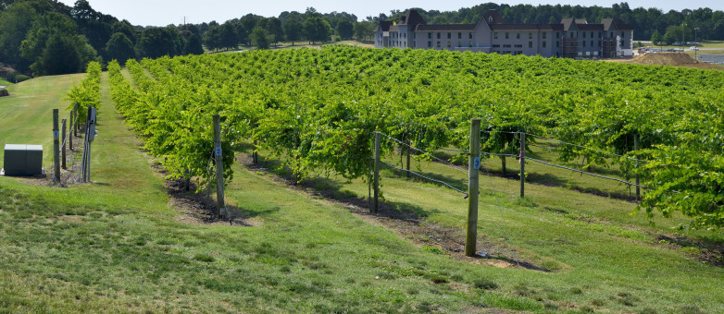
Late delivery = Actual_Delivery > Expected_Delivery
Unit_Price is treated as selling price in Shipment_Detail (no cost data provided).
Last four quarters reflect data contents, not the current calendar.
Distributors sell all SKUs received; Employee_Hour entries are assumed complete.
ERD kept in 3NF; reorder levels optional.
Assumptions

Slide 14
Summary
The ERD provides the structure needed to evaluate supplier reliability, product movement, and staffing trends.
The four reports highlight patterns in delivery timing, wine distribution performance, quarterly sales shifts, and employee workload.
These insights support better planning across production, distribution, and resource management.
Next Steps
Review supplier performance monthly to stay ahead of delivery issues.
Adjust production or distributor strategy based on wine sales and quarterly trends.
Revisit staffing distribution each quarter to prevent overload and maintain workflow balance.
Continue refining the reporting process as new data is added.

Slide 15
Questions?

